Slide 1


Connective Tissue
Dr. Mahdi H. Hammadi
PhD Sc. Clinical Physiology

Slide 2
Connective Tissue
Connective tissue provides a matrix that connects and binds the cells and organs and ultimately gives support to the body
The main constituent of connective tissue is the extracellular matrix. Due to this abundance of extracellular matrix, the cells in connective tissues are widely placed. Other tissues (like epithelium, muscular and nervous) are formed mainly by cells.

Slide 3
The function of connective tissues:
The Loose areolar tissue holds together structures like skin, muscles, blood vessels etc. and binds together the various layers of hollow viscera (stomach, intestine, urinary bladder, uterus).
Reticular tissue forms a framework that supports the cellular elements of various organs like spleen, lymph nodes and glands.
Enables the movement of skin over underlying structure.
Allows mobility and stretching in hollow organs.
Hold the bone at joints (in the form of ligament).
Provide attachment for origin and insertions of many muscles
Hold the tendons of muscles at wrist and ankle
Provides support and protection to the brain and spinal cord

Slide 4
Other functions:
The matrix serves as medium through which nutrients and metabolic wastes are exchanged between cells and their blood supply.
Provides immunity: due to presence of cells of immune system - macrophages and plasma cells.
Wound repair: Fibroblast produces the collagen fibres necessary for wound repair.
Adipose tissue stores nutrition

Slide 5
Regeneration of tissues (like cartilage and bone) due to the presence of undifferentiated mesenchymal cells.

Slide 6
Connective Tissues are broadly classified into:
General Connective tissue
Specialized connective tissue (Bone, Blood, cartilage)

Slide 7
General Connective Tissue
The constituents for general connective tissues are as follow:
Cells
Fibres
Ground substance

Slide 8
Cells
Mesenchymal cell
Pigment cells
Macrophages
Lymphocytes
Plasma cells

Slide 9
Various other types are also recognized
Collagen Fibers:
Elastic Fibers
Ground substance

Slide 10
Types of Connective tissue
Loose areolar- e.g. superficial fascia
Dense irregular – e.g. dermis of the skin
Dense regular- e.g. tendon
Elastic Tissue- e.g. ligamentum flava
Adipose Tissue
Connective tissue is divided into four main categories:
Connective proper
Cartilage
Bone
Blood

Slide 11
Connective tissue proper has two subclasses: loose and dense. Loose connective tissue is divided into 1) areolar, 2) adipose, 3)
reticular. Dense connective tissue is divided into 1) dense regular, 2) dense irregular, 3) elastic

Slide 12
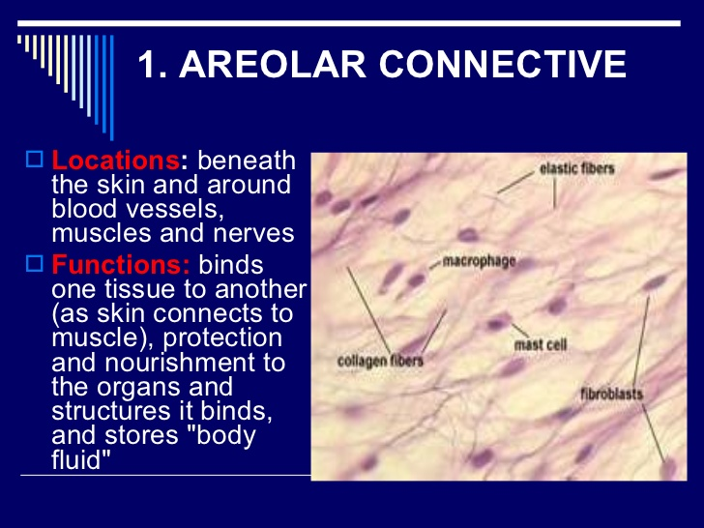
1- Loose Connective tissue:
Areolar Connective Tissue

Slide 13
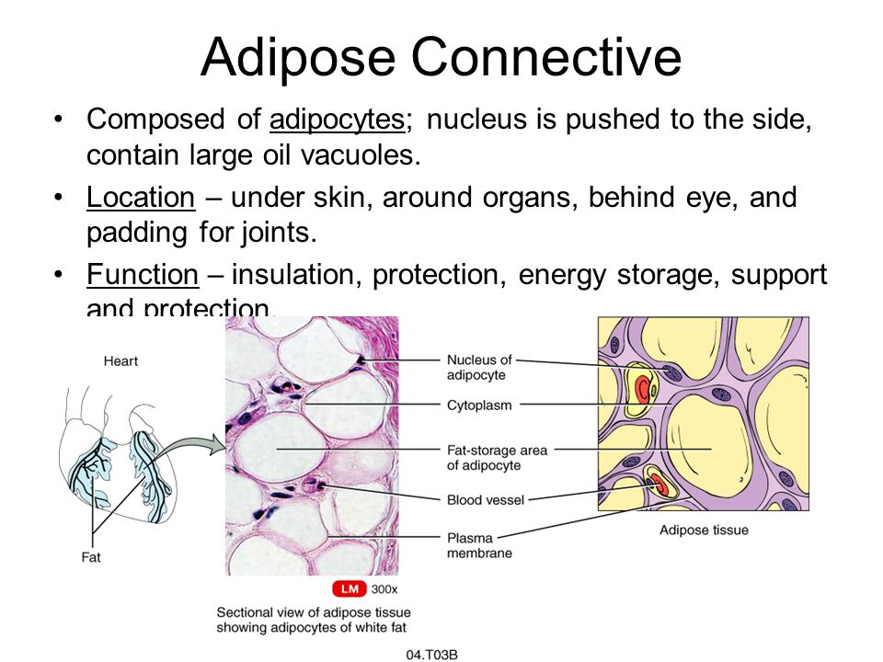

Slide 14
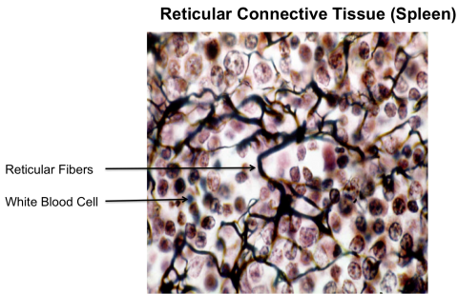

Slide 15
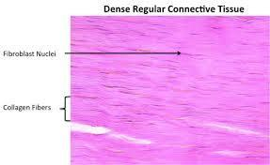

Slide 16
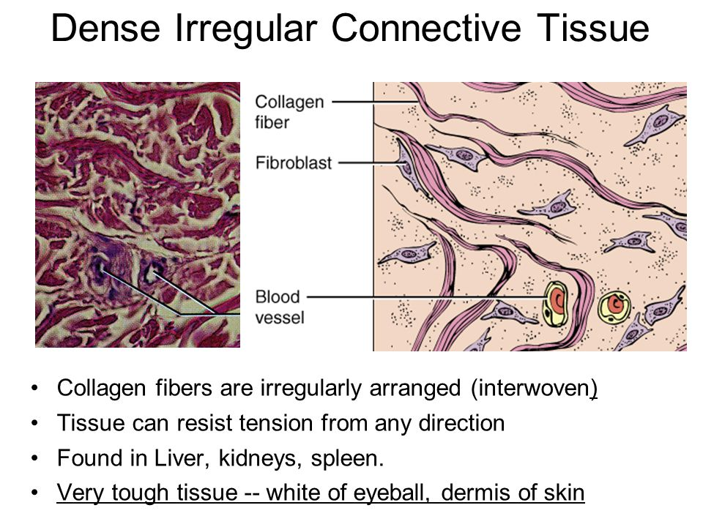

Slide 17
Elastic Connective Tissue
The main fibers that form this tissue are elastic in nature. These fibers allow the tissues to recoil after stretching. This is especially seen in the arterial blood vessels and walls of the bronchial tubes.

